Slide 1
Natural Language Processing
Lecture 7: Language Modeling

Slide 2
Language Modeling
Is this sentences good?
This is a beautiful flower
Flower this is a beautiful
Help choose between options, help score options
Rooster released from police custody in Sindh after eight months
سندھ میں آٹھ ماہ بعد مرغا کی پولیس تحویل سے رہائی
سندھ میں آٹھ ماہ بعد مرغے کا پولیس تحویل سے رہائی
مرغی کو آٹھ ماہ بعد سندھ میں پولیس کی تحویل سے رہا کیا گیا
سندھ میں آٹھ ماہ بعد مرغے کی پولیس تحویل سے رہائی

Slide 3
Language Modeling
Spell Correction
The office is about fifteen minuets from my house
P(about fifteen minutes from) > P(about fifteen minuets from)
Speech Recognition
P(I saw a van) >> P(eyes awe of an)
+ Summarization, question-answering, etc., etc.!!

Slide 4
Revision
Random variable takes different values, depending on chance
Probability: p(X = x)
Conditional Probability: p(X = x , Y = y)
Independence
Chain Rule
Joined Probability: p(X = x | Y = y)

Slide 5
Language Modeling
Goal: compute the probability of a sentence or sequence of words:
P(W) = P(w₁,w₂,w₃,w₄,w₅…w_{n})
Related task: probability of an upcoming word:
P(w₅|w₁,w₂,w₃,w₄)
A model that computes either of these:
P(W) or P(w_{n}|w₁,w₂…w_{n-1}) is called a language model.
Better: the grammar But language model or LM is standard

Slide 6
How to compute P(W)
How to compute this joint probability:
P(its, water, is, so, transparent, that)
Intuition: let’s rely on the Chain Rule of Probability

Slide 7
Reminder: The Chain Rule
Recall the definition of conditional probabilities
P(A|B) = P(A,B) / P(B)
Rewriting:
P(A|B) P(B)= P(A,B)
More variables:
P(A,B,C,D) = P(A)P(B|A)P(C|A,B)P(D|A,B,C)
The Chain Rule in General
P(x₁,x₂,x₃,…,x_{n}) =
P(x₁)P(x₂|x₁)P(x₃|x₁,x₂)…P(x_{n}|x₁,…,x_{n-1})

Slide 8
The Chain Rule applied to compute joint probability of words in sentence
P(“its water is so transparent”) =
P(its) × P(water|its) × P(is|its water)
× P(so|its water is) × P(transparent|its water is so)

Slide 9
How to estimate these probabilities
Could we just count and divide?
No! Too many possible sentences!
We’ll never see enough data for estimating these

Slide 10
Markov Assumption
Simplifying assumption:
Or maybe

Slide 11
Markov Assumption
In other words, we approximate each component in the product

Slide 12
Simplest case: Unigram model
Every word in Σ is assigned some probability.
Random variables W1 , W2 , ... (one per word).

Slide 13
Unigram Distribution
p(the) = 0.038
p(of) = 0.023
p(and) = 0.021
p(to) = 0.017
p(is) = 0.013
p(a) = 0.012
p(in) = 0.012
p(for) = 0.009
p(joint) = 0.00014 p(relatvely) = 0.00014 p(plot) = 0.00014 p(DEL1SUBSEQ) = 0.00014
p(rule) = 0.00014
p(62.0) = 0.00014
p(9.1) = 0.00014 p(evaluated) = 0.00014

Slide 14
Unigram Model As a Generator
Some automatically generated sentences from a unigram model
fifth, an, of, futures, the, an, incorporated, a, a, the, inflation, most, dollars, quarter, in, is, mass
thrift, did, eighty, said, hard, 'm, july, bullish
that, or, limited, the

Slide 15
Bigram model
Condition on the previous word:
texaco, rose, one, in, this, issue, is, pursuing, growth, in, a, boiler, house, said, mr., gurria, mexico, 's, motion, control, proposal, without, permission, from, five, hundred, fifty, five, yen
outside, new, car, parking, lot, of, the, agreement, reached
this, would, be, a, record, november

Slide 16
N-gram models
We can extend to trigrams, 4-grams, 5-grams
In general this is an insufficient model of language
because language has long-distance dependencies:
“The computer which I had just put into the machine room on the fifth floor crashed.”
But we can often get away with N-gram models

Slide 17
Example
تازہ ترین جھڑپوں کے باوجود انڈیا نے اشارہ دیا ہے
Unigram Model
P(تازہ ترین جھڑپوں کے باوجود انڈیا نے اشارہ دیا ہے ) =
P(تازہ ) * P(ترین ) * P(جھڑپوں ) *P(کے ) * P(باوجود ) *P(انڈیا ) *P(نے ) *P(اشارہ ) * P(دیا ) * P(ہے)

Slide 18
Example
تازہ ترین جھڑپوں کے باوجود انڈیا نے اشارہ دیا ہے
Bigram Model
P(تازہ ترین جھڑپوں کے باوجود انڈیا نے اشارہ دیا ہے ) =
P(تازہ ) *
P(ترین | تازہ ) *
P(جھڑپوں | ترین) *
P(کے| جھڑپوں) *
P(باوجود| کے) *
P(انڈیا| باوجود ) *
P(نے | انڈیا ) *
P(اشارہ | نے ) *
P(دیا | اشارہ ) *
P(ہے| دیا )

Slide 19
Example
تازہ ترین جھڑپوں کے باوجود انڈیا نے اشارہ دیا ہے
Trigram Model
P(تازہ ترین جھڑپوں کے باوجود انڈیا نے اشارہ دیا ہے ) =
P(تازہ ) *
P(ترین | تازہ ) *
P(جھڑپوں | ترین تازہ) *
P(کے| جھڑپوں ترین) *
P(باوجود| کے جھڑپوں) *
P(انڈیا| کے باوجود ) *
P(نے | باوجود انڈیا ) *
P(اشارہ | انڈیا نے ) *
P(دیا | نے اشارہ ) *
P(ہے| اشارہ دیا )

Slide 20
Estimating N-gram Probabilities

Slide 21
Estimating bigram probabilities
The Maximum Likelihood Estimate (MLE)
Counts from a corpus
Normalizing the counts so that they lie between 0 and 1

Slide 22
An example
<s> یہ ایک پل ہے</s>
<s> یہ لکڑی کا پل ہے</s>
<s> پل یہ دو شہروں کو ملاتا ہے</s>
P(ہے | پل) = 2/3 =0.67
P(یہ | <s>) = Count(<s> یہ ) / count(<s>)
P(یہ | <s>) = 2/3 = 0.67
P( ایک| یہ) = Count(ایک یہ ) / count(یہ)
P( ایک| یہ) = 1/3 = 0.333
Notes:
Let’s work through an example using a mini-corpus of three sentences. We’ll
first need to augment each sentence with a special symbol <s> at the beginning
of the sentence, to give us the bigram context of the first word. We’ll also need a
special end-symbol. </s>

Slide 23

Another example
<s> I am Sam </s>
<s> Sam I am </s>
<s> I do not like green eggs and ham </s>

Slide 24
More examples: Berkeley Restaurant Project sentences
can you tell me about any good cantonese restaurants close by
mid priced thai food is what i’m looking for
tell me about chez panisse
can you give me a listing of the kinds of food that are available
i’m looking for a good place to eat breakfast
when is caffe venezia open during the day

Slide 25
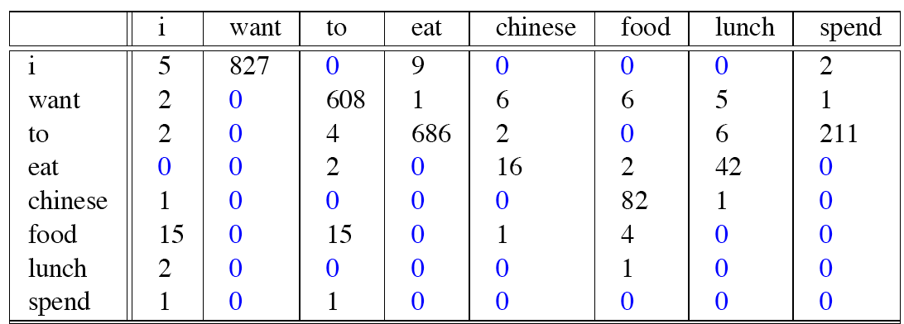
Raw bigram counts
Out of 9222 sentences

Slide 26
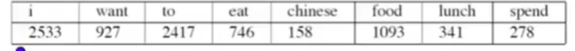
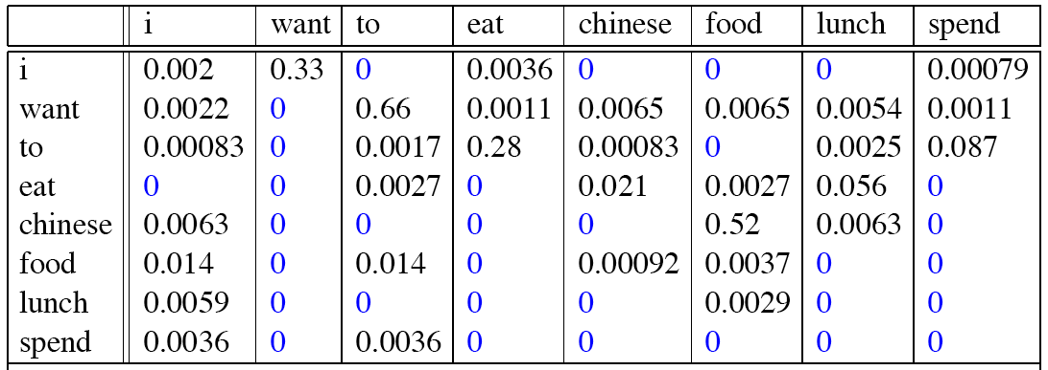
Raw bigram probabilities

Slide 27
Bigram estimates of sentence probabilities
P(i|<s>) = 0.25, P(english|want) = 0.0011,
P(food|english) = 0.5, P(</s>|food) = 0.68,
P(<s> I want english food </s>) =
P(I|<s>)
× P(want|I)
× P(english|want)
× P(food|english)
× P(</s>|food)
= .000031

Slide 28
What kinds of knowledge?
P(english|want) = .0011
P(chinese|want) = .0065
P(to|want) = .66
P(eat | to) = .28
P(food | to) = 0
P(want | spend) = 0
P (i | <s>) = .25

Slide 29
Practical Issues
We do everything in log space
Avoid underflow
(also adding is faster than multiplying)

